Slide 1




AREA II:
LAND AND WATER RESOURCES ENGINEERING
Prepared by: Engr. Nicole Jane J. Lim
ABELE | 2025
ATTRC - Iligan City

Slide 2
IRRIGATION AND DRAINAGE ENGINEERING
Surveying
Pumps
Fluid Mechanics
Open Channel
Groundwater Hydrology
Pressurized Irrigation Systems

Slide 3
IRRIGATION AND DRAINAGE ENGINEERING
Surveying
Pumps
Fluid Mechanics
Open Channel
Groundwater Hydrology
Pressurized Irrigation Systems

Slide 4
Surveying
Pumps
FLUID MECHANICS
Open Channel
Groundwater Hydrology
Pressurized Irrigation Systems

Slide 5
QUESTION 1
This property is defined as a measure of a fluid's resistance to flow, and describes the internal friction of a moving fluid.
Shear rate
Viscosity
Consistency
Density
Reference: https://chem.libretexts.org/Courses/University_of_Arkansas_Little_Rock/Chem_1402%3A_General_Chemistry_1_(Kattoum)
ATTRC ABELE Review 2025
Irrigation and Drainage Engineering | Fluid Mechanics

Slide 6
Some Properties of Fluid Relevant in ABE
Density - determines the mass of a fluid per unit volume and affects flow rates, buoyancy, and energy requirements in pumping systems. In irrigation, knowing the density helps calculate the force needed to move water through pipes and canals. It also affects the design of fluid storage and distribution systems.
Specific Gravity - this dimensionless property is the ratio of a fluid's density to that of water (reference density). Specific gravity helps in comparing different fluids in applications such as liquid fertilizers or pesticides, where the fluid's behavior under different conditions affects distribution.
Compressibility: Compressibility refers to the change in fluid volume under pressure. In ABE, most liquids are considered incompressible for ease of calculations. However, understanding compressibility is critical in systems where gases are involved, such as in pneumatic systems or air-assisted spraying, as it influences the system's efficiency and energy consumption.
Reference: http://ecoursesonline.iasri.res.in/mod/resource/view.php?id=147003
ATTRC ABELE Review 2025
Irrigation and Drainage Engineering | Fluid Mechanics

Slide 7
Some Properties of Fluid Relevant in ABE
Capillarity: This property is the ability of a fluid to move through small spaces due to adhesive and cohesive forces. Capillary action is significant in soil moisture movement, affecting water availability to plants. It is also crucial in designing irrigation systems, particularly drip irrigation, where the controlled release of water relies on capillary action to spread moisture uniformly around roots.
Surface Tension: Surface tension affects the behavior of liquids at the interface with other materials. In agricultural spraying, surface tension impacts droplet formation, spread, and adhesion on plant surfaces, which are essential for effective pesticide or nutrient application. In micro-irrigation, controlling surface tension helps improve water distribution and minimize evaporation losses.
Pressure - pressure in fluids is determined by depth, density, and gravity. Understanding pressure is critical in designing water delivery systems, such as pumps and pipes, where sufficient pressure must be maintained to transport water efficiently. In irrigation, managing pressure ensures even water distribution, reducing energy costs and optimizing water use.
Reference: http://ecoursesonline.iasri.res.in/mod/resource/view.php?id=147003
ATTRTC ABELE Review 2024
ATTRC ABELE Review 2025
Irrigation and Drainage Engineering | Fluid Mechanics
Irrigation and Drainage Engineering | Fluid Mechanics

Slide 8
QUESTION 2
Hydrometer is an instrument used to determine what characteristic of fluid?
Humidity
Flow rate
Velocity
Specific gravity
ATTRTC ABELE Review 2024
ATTRC ABELE Review 2025
Irrigation and Drainage Engineering | Fluid Mechanics
Irrigation and Drainage Engineering | Fluid Mechanics

Slide 9
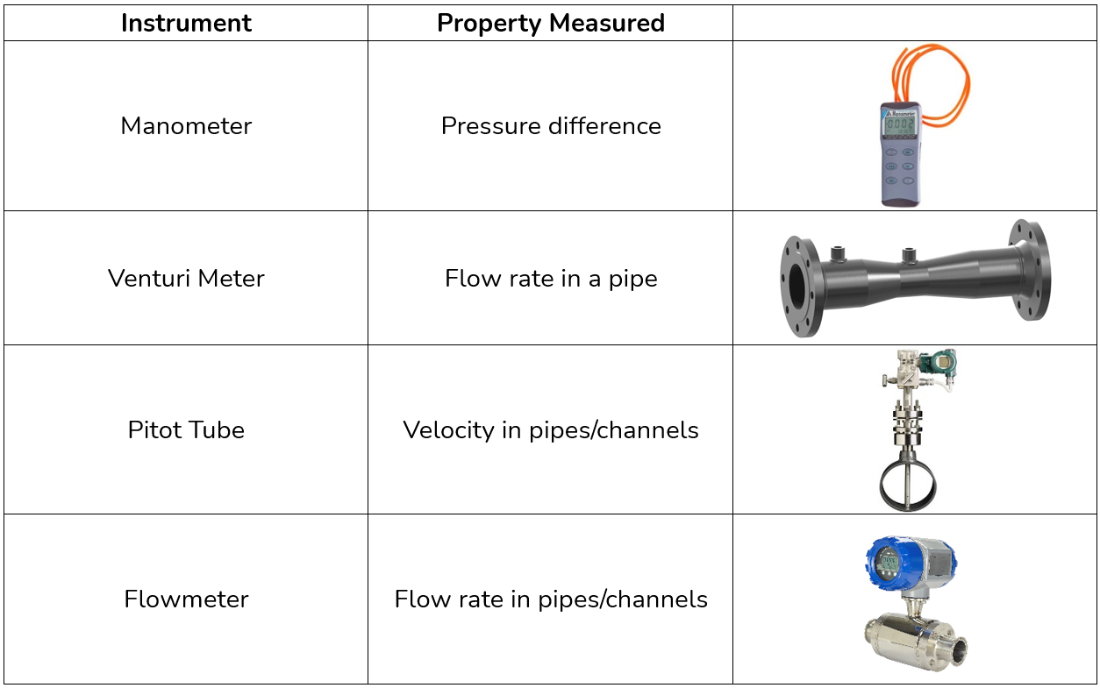
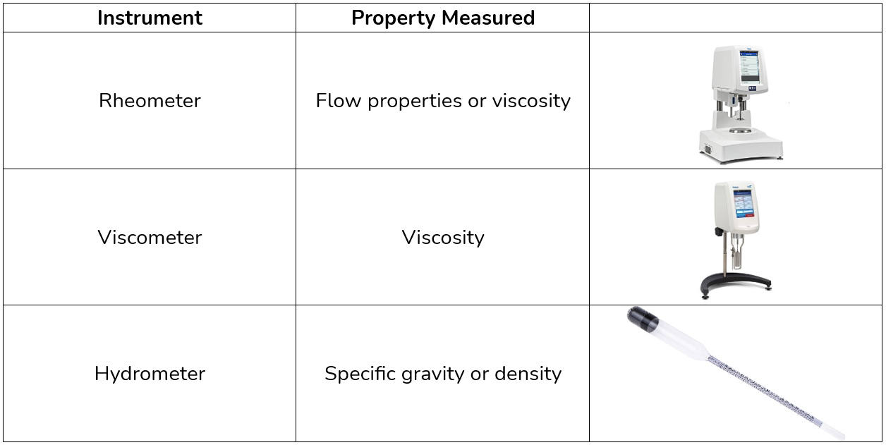
Some Fluid Mechanics Measuring Instruments
A hydrometer measures the density (specific gravity) of liquids, while a hygrometer measures the humidity (water vapor in the air).
Reference: https://www.laboratorydeal.com/blogs/blogs/fluid-mechanics-physics-instruments-equipment
ATTRTC ABELE Review 2024
ATTRC ABELE Review 2025
Irrigation and Drainage Engineering | Fluid Mechanics
Irrigation and Drainage Engineering | Fluid Mechanics

Slide 10
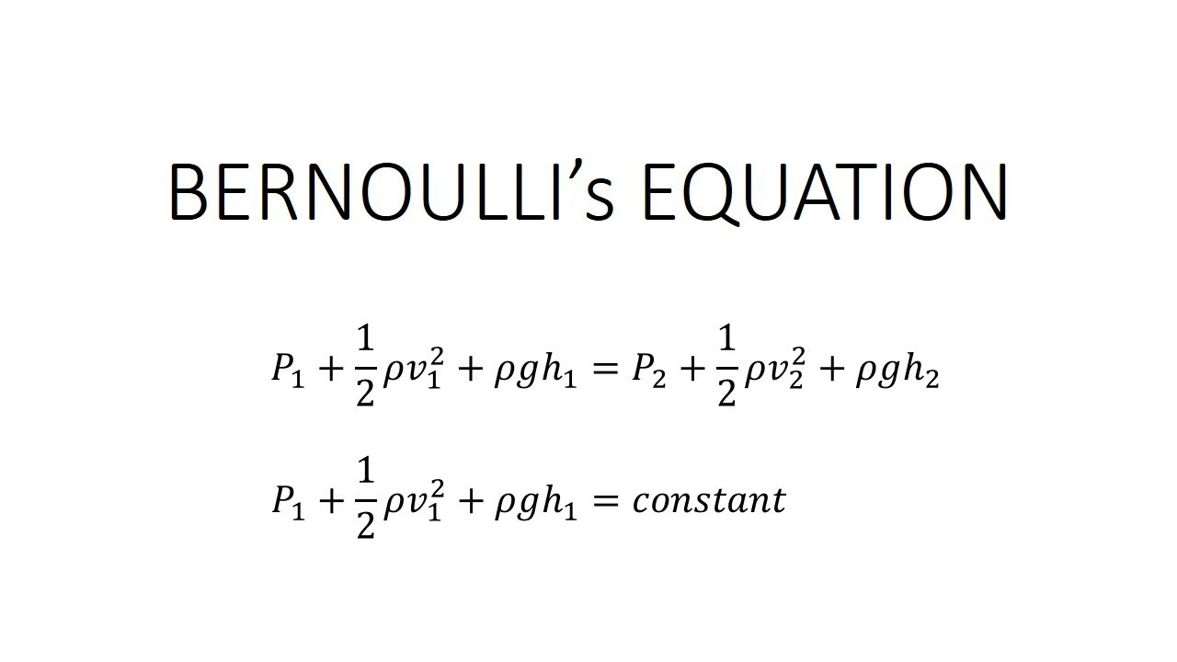
QUESTION 3
Which of the following concepts derives its principle from the law of conservation of energy?
Darcy’s equation
Manning’s equation
Bernoulli’s equation
Hagen-Poisceuille equation
ATTRTC ABELE Review 2024
ATTRC ABELE Review 2025
Irrigation and Drainage Engineering | Fluid Mechanics
Irrigation and Drainage Engineering | Fluid Mechanics

Slide 11
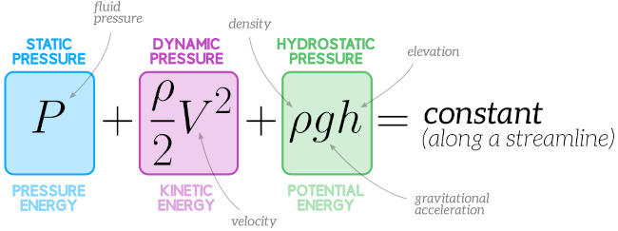
ATTRTC ABELE Review 2024
ATTRC ABELE Review 2025
Irrigation and Drainage Engineering | Fluid Mechanics
Irrigation and Drainage Engineering | Fluid Mechanics

Slide 12
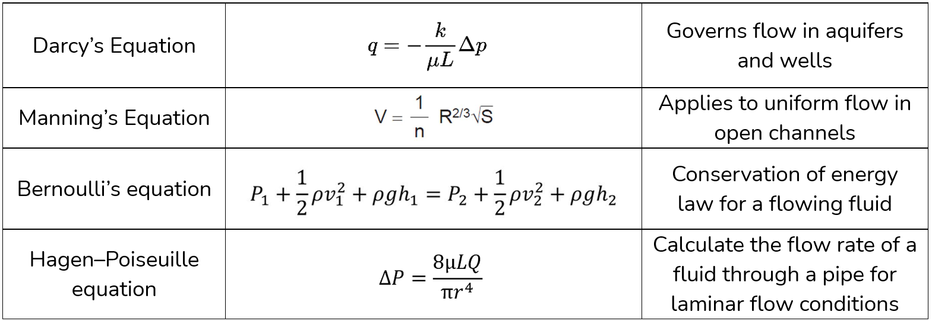
Darcy’s, Manning’s, Bernoulli’s, and Hagen-Poiseuille Equation and their Application in ABE
Take note: Darcy’s law is only applicable for laminar flow. It defines the flow of a fluid through a porous medium
ATTRTC ABELE Review 2024
ATTRC ABELE Review 2025
Irrigation and Drainage Engineering | Fluid Mechanics
Irrigation and Drainage Engineering | Fluid Mechanics

Slide 13
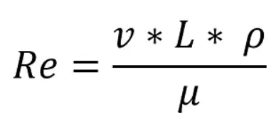
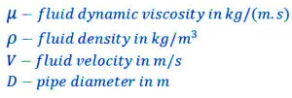
QUESTION 4
This is a dimensionless number that gives a measure of the ratio of inertial forces to viscous forces and, consequently, it quantifies the relative importance of these two types of forces for
given flow conditions.
- represents the ratio of inertial to viscous forces within a fluid
- relates the viscosity of a fluid to its thermal conductivity
- ratio of convective heat transfer to conductive heat transfer in a fluid system
- number of units in one mole of any substance
Reynolds Number
Prandtl Number
Nusselt Number
Avogadro's Number
Reference: https://chem.libretexts.org/Courses/University_of_Arkansas_Little_Rock/Chem_1402%3A_General_Chemistry_1_(Kattoum)
ATTRTC ABELE Review 2024
ATTRC ABELE Review 2025
Irrigation and Drainage Engineering | Fluid Mechanics
Irrigation and Drainage Engineering | Fluid Mechanics

Slide 14
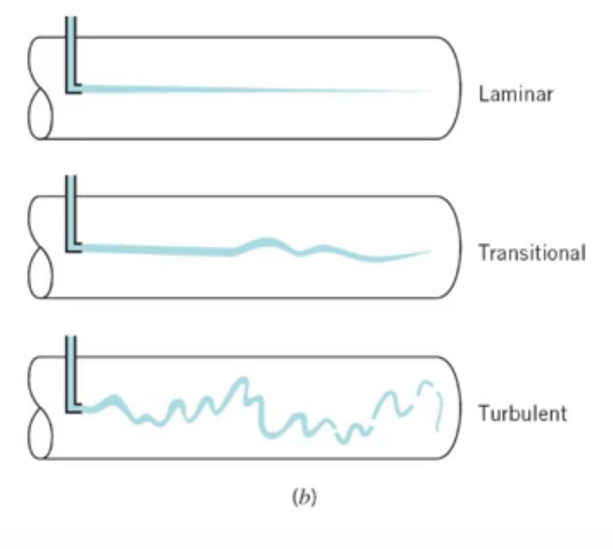
QUESTION 5
Reynold’s number for laminar flow is?
Laminar flow
Transitional flow
Turbulent flow
Re < 2000
2000 < Re < 4000
Re > 4000
Re = 0
-----------------
Reference: https://chem.libretexts.org/Courses/University_of_Arkansas_Little_Rock/Chem_1402%3A_General_Chemistry_1_(Kattoum)
ATTRTC ABELE Review 2024
ATTRC ABELE Review 2025
Irrigation and Drainage Engineering | Fluid Mechanics
Irrigation and Drainage Engineering | Fluid Mechanics

Slide 15
QUESTION 6
This type of flow is one in which all conditions at any point in a stream remain constant with respect to time.
Uniform flow
Non-uniform flow
Steady flow
Unsteady flow
Reference: https://learn.lboro.ac.uk/pluginfile.php/504741/mod_resource/content/1/Fluid_Mechanics_3.pdf
ATTRTC ABELE Review 2024
ATTRC ABELE Review 2025
Irrigation and Drainage Engineering | Fluid Mechanics
Irrigation and Drainage Engineering | Fluid Mechanics

Slide 16
QUESTION 7
If the flow velocity is the same magnitude and direction at every point in the fluid, it is said to be in this type of flow.
Uniform flow
Non-uniform flow
Steady flow
Unsteady flow
Reference: https://learn.lboro.ac.uk/pluginfile.php/504741/mod_resource/content/1/Fluid_Mechanics_3.pdf
ATTRTC ABELE Review 2024
ATTRC ABELE Review 2025
Irrigation and Drainage Engineering | Fluid Mechanics
Irrigation and Drainage Engineering | Fluid Mechanics

Slide 17
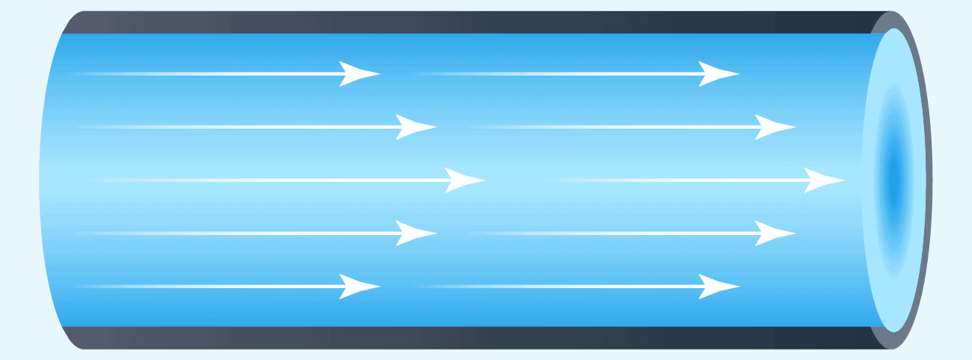
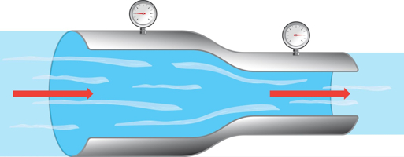
Flow velocity is the same magnitude and direction at all points
Point A = Point B = Point C = …
Uniform flow
This type of flow is one in which all conditions at any point in a stream remain constant with respect to time.
Point A @ T1 = Point A @ T2 = …
Point B @ T1 = Point B @ T2 = …
Steady flow
ATTRTC ABELE Review 2024
ATTRC ABELE Review 2025
Irrigation and Drainage Engineering | Fluid Mechanics
Irrigation and Drainage Engineering | Fluid Mechanics

Slide 18
Uniform flow
Uniform flow
The flow velocity is the same magnitude and direction at every point in the fluid.
Non-uniform flow
The velocity is not the same at every point.
Non-uniform flow
Steady flow
The conditions (velocity, pressure and cross-section) may differ from point to point but do not change with time.
Steady flow
Unsteady flow
The conditions change with time.
Unsteady flow
In practice there is always slight variations in velocity and pressure, but if the average values are constant, the flow is considered steady.
Reference: https://learn.lboro.ac.uk/pluginfile.php/504741/mod_resource/content/1/Fluid_Mechanics_3.pdf
ATTRTC ABELE Review 2024
ATTRC ABELE Review 2025
Irrigation and Drainage Engineering | Fluid Mechanics
Irrigation and Drainage Engineering | Fluid Mechanics

Slide 19
Steady flow
Uniform flow
Steady uniform flow
The flow velocity is the same magnitude and direction at every point in the fluid.
Conditions do not change with position in the stream or with
time.
The velocity is not the same at every point.
Steady non-uniform flow
Steady flow
Non-uniform flow
Conditions change from point to point in the stream but
do not change with time.
Unsteady uniform flow
At a given instant in time the conditions at every point are
the same, but will change with time.
Unsteady flow
The conditions (velocity, pressure and cross-section) may differ from point to point but do not change with time.
Uniform flow
Unsteady flow
Non-uniform flow
The conditions change with time.
Unsteady non-uniform flow
Every condition of the flow may change from point to
point and with time at every point.
Reference: https://learn.lboro.ac.uk/pluginfile.php/504741/mod_resource/content/1/Fluid_Mechanics_3.pdf
ATTRTC ABELE Review 2024
ATTRC ABELE Review 2025
Irrigation and Drainage Engineering | Fluid Mechanics
Irrigation and Drainage Engineering | Fluid Mechanics

Slide 20
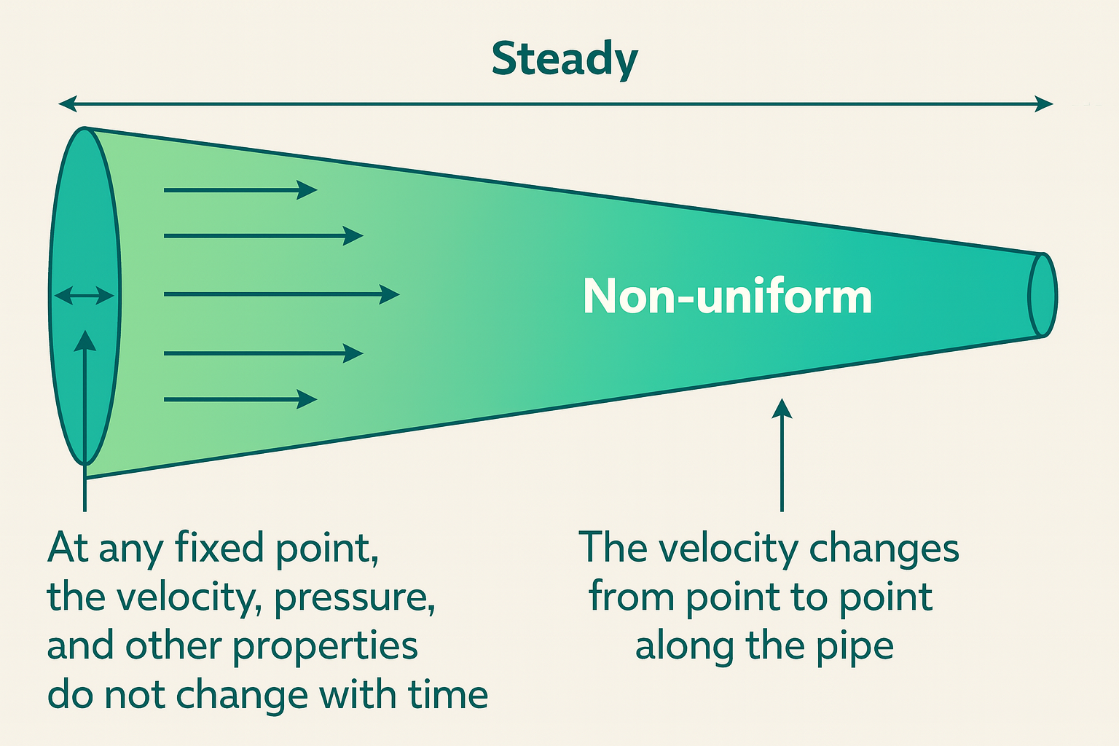
ADDITIONAL QUESTION
What type of flow does a water flowing at a constant rate through a conical pipe exhibit, based on the previous discussion?
Water flowing at a constant rate through a conical pipe exhibits steady, non-uniform flow.
Why steady?
The flow rate is constant over time.
This means that at any fixed point in the pipe, the velocity, pressure, and other properties do not change with time.
Why non-uniform?
The cross-sectional area of a conical pipe changes (either narrowing or widening).
So the velocity changes from point to point along the pipe due to continuity (as area decreases, velocity increases, and vice versa).
Hence, flow properties vary with position, making it non-uniform in space.
Reference: https://chem.libretexts.org/Courses/University_of_Arkansas_Little_Rock/Chem_1402%3A_General_Chemistry_1_(Kattoum)
ATTRTC ABELE Review 2024
ATTRC ABELE Review 2025
Irrigation and Drainage Engineering | Fluid Mechanics
Irrigation and Drainage Engineering | Fluid Mechanics

Slide 21
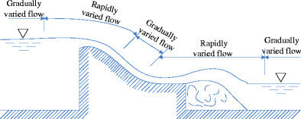
QUESTION 8
A hydraulic jump is an example of which type of flow?
Laminar
Turbulent
Gradually varied flow
Rapidly varied flow
Rapidly-varied flow is a significant change in water depth over a short distance. Gradually Varied Flow (GVF) is the flow where the water depth changes gradually over a large distance and usually connects RVF and UF.
Reference: https://chem.libretexts.org/Courses/University_of_Arkansas_Little_Rock/Chem_1402%3A_General_Chemistry_1_(Kattoum)
ATTRTC ABELE Review 2024
ATTRC ABELE Review 2025
Irrigation and Drainage Engineering | Fluid Mechanics
Irrigation and Drainage Engineering | Fluid Mechanics

Slide 22

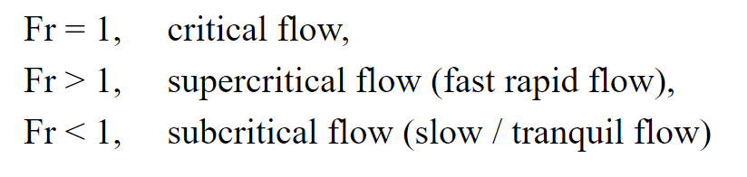
QUESTION 8
This dimensionless number which represents the ratio of inertial and gravitational forces value and describes different flow regimes of open channel flow.
Reynold’s number
Froude’s number
Weber's number
Euler's number
Reference: https://www.fsl.orst.edu/geowater/FX3/help/8_Hydraulic_Reference/Froude_Number_and_Flow_States.htm
ATTRTC ABELE Review 2024
ATTRC ABELE Review 2025
Irrigation and Drainage Engineering | Fluid Mechanics
Irrigation and Drainage Engineering | Fluid Mechanics

Slide 23
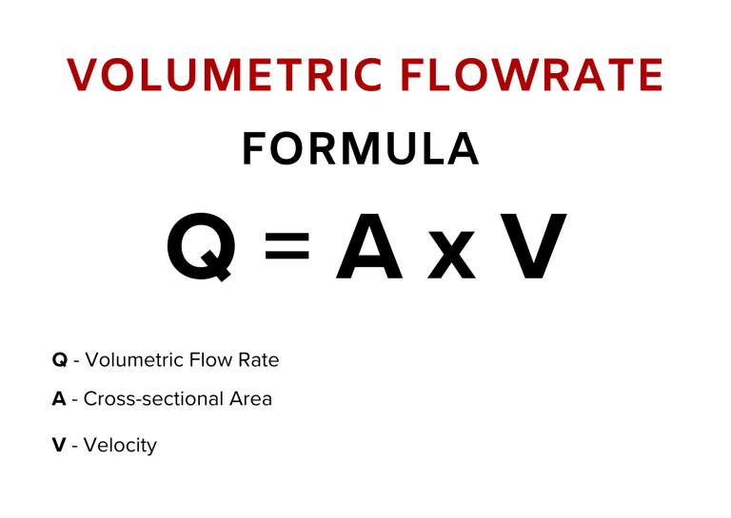
QUESTION 9
What is the rate of flow of coconut oil in a 2 in. pipe if the velocity of the fluid is measured at 0.02 m/s? The specific weight of oil is 1500 kg/cubic meter?
0.01lps
0.02lps
0.03lps
0.04lps
ATTRTC ABELE Review 2024
ATTRC ABELE Review 2025
Irrigation and Drainage Engineering | Fluid Mechanics
Irrigation and Drainage Engineering | Fluid Mechanics

Slide 24
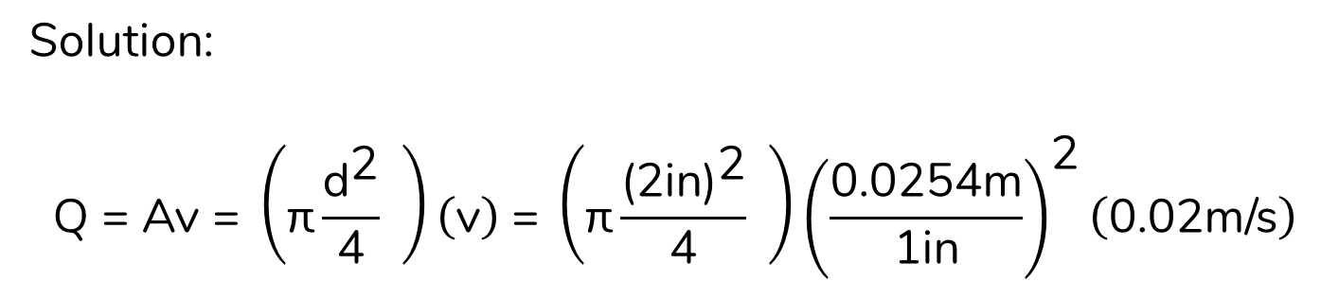
QUESTION 9
What is the rate of flow of coconut oil in a 2 in. pipe if the velocity of the fluid is measured at 0.02 m/s? The specific weight of oil is 1500 kg/cubic meter?
0.01lps
0.02lps
0.03lps
0.04lps
Solution:
$$\text{Q}\text{ = }\text{Av}\text{ = }\left(\text{π}\frac{{\text{d}}^{\text{2}}}{\text{4}} \right)\left(\text{v}\right) \text{= }\left(\text{π}\frac{{\text{(2}\text{in}\text{)}}^{\text{2}}}{\text{4}} \right){\left(\frac{\text{0.0254}\text{m}}{\text{1}\text{in}}\right)}^{\text{2}}\left(\text{0.02}\text{m}\text{/}\text{s}\right)$$
Q = 0.00004054m3/s or 0.04lps
ATTRTC ABELE Review 2024
ATTRC ABELE Review 2025
Irrigation and Drainage Engineering | Fluid Mechanics
Irrigation and Drainage Engineering | Fluid Mechanics

Slide 25
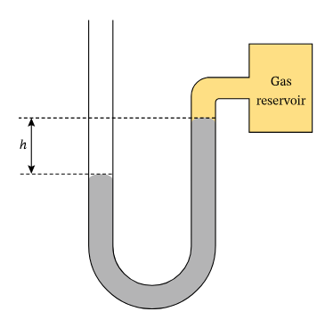
QUESTION 10
The U-shaped tube as shown contains mercury that has a density of 13‎ ‎595 kg/m³. The top of the mercury column in contact with the atmosphere is vertically below the top of the mercury column in contact with the gas reservoir. The vertical distance between the column tops h = 25cm. Find the pressure of the gas in the reservoir.
33kPa
68kPa
101kPa
105kPa
-----------
-----------
Liquid Manometer Equation: ΔP = ρgΔh
Reference: https://www.nagwa.com/en/explainers/216152184514/
ATTRTC ABELE Review 2024
ATTRC ABELE Review 2025
Irrigation and Drainage Engineering | Fluid Mechanics
Irrigation and Drainage Engineering | Fluid Mechanics

Slide 26
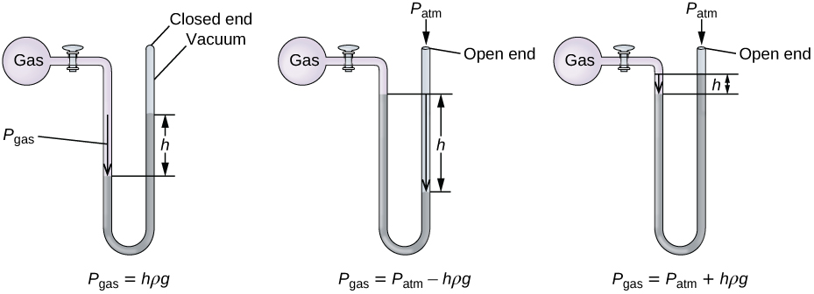
Recall: Pressure measurement using the height of a liquid column in a U-shaped manometer
$$\text{∆}\text{P}\text{ = }\text{ρg}\text{∆}\text{h}$$
Reference: https://www.nagwa.com/en/explainers/216152184514/
ATTRTC ABELE Review 2024
ATTRC ABELE Review 2025
Irrigation and Drainage Engineering | Fluid Mechanics
Irrigation and Drainage Engineering | Fluid Mechanics

Slide 27
QUESTION 10
The U-shaped tube as shown contains mercury that has a density of 13‎ ‎595 kg/m³.The top of the mercury column in contact with the atmosphere is vertically below the top of the mercury column in contact with the gas reservoir. The vertical distance between the column tops h = 25cm. Find the pressure of the gas in the reservoir.
Solution:
P_{g} = Patm - ρgΔh
P_{g} = 101.3kPa – (13595kg/m3)(9.81m/s2)(0.25m)
P_{g} = 67.95kPa
33kPa
68kPa
101kPa
105kPa
-----------
-----------
Liquid Manometer Equation: ΔP = ρgΔh
Reference: https://www.nagwa.com/en/explainers/216152184514/
ATTRTC ABELE Review 2024
ATTRC ABELE Review 2025
Irrigation and Drainage Engineering | Fluid Mechanics
Irrigation and Drainage Engineering | Fluid Mechanics

Slide 28
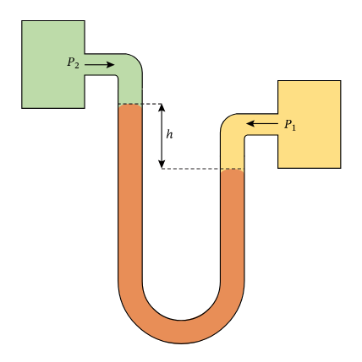
QUESTION 11
The pressures of the gas reservoirs are P = 110.3kPa and P = 110.1kPa.The U-shaped tube contains an oil with a density of 1‎ ‎080 kg/m³. What is the vertical distance h between the tops of the oil columns?
Solution:
ΔP = ρgΔh
(110.3kPa – 110.1kPa) x 1000Pa/kPa = (1080kg/m3)(9.81m/s2) Δh
Δh = 0.0189m or 1.89cm
2.54cm
2.25cm
1.92cm
1.89cm
Liquid Manometer Equation: ΔP = ρgΔh
Reference: https://www.nagwa.com/en/explainers/216152184514/
ATTRTC ABELE Review 2024
ATTRC ABELE Review 2025
Irrigation and Drainage Engineering | Fluid Mechanics
Irrigation and Drainage Engineering | Fluid Mechanics

Slide 29

QUESTION 11
Using Bernoulli’s equation, find the velocity at the end of a pipe given the following conditions:
V = 0.8m/s
P1 = 15kPa
P2 = 13kPa
Density = 1.2g/cc
Solution:
$$\frac{1}{2}ρν_{1}^{2}+ρgh_{1}{+P}_{1}=\frac{1}{2}ρν_{2}^{2}+ρgh_{1}+P_{2}$$
$$\frac{1}{2}ρν_{1}^{2}+P_{1}=\frac{1}{2}ρν_{2}^{2}+P_{2}$$
$$\frac{1}{2}(1200kg/m3){\left(\frac{0.8m}{s}\right)}^{2}+(15000Pa)=\frac{1}{2}(1200kg/m3)ν_{2}^{2}+(13000Pa)$$
Using shift solve:
v₂ = 1.99m/s
1.66m/s
1.77m/s
1.88m/s
1.99m/s
Reference: https://www.fsl.orst.edu/geowater/FX3/help/8_Hydraulic_Reference/Froude_Number_and_Flow_States.htm
ATTRTC ABELE Review 2024
ATTRC ABELE Review 2025
Irrigation and Drainage Engineering | Fluid Mechanics
Irrigation and Drainage Engineering | Fluid Mechanics

Slide 30
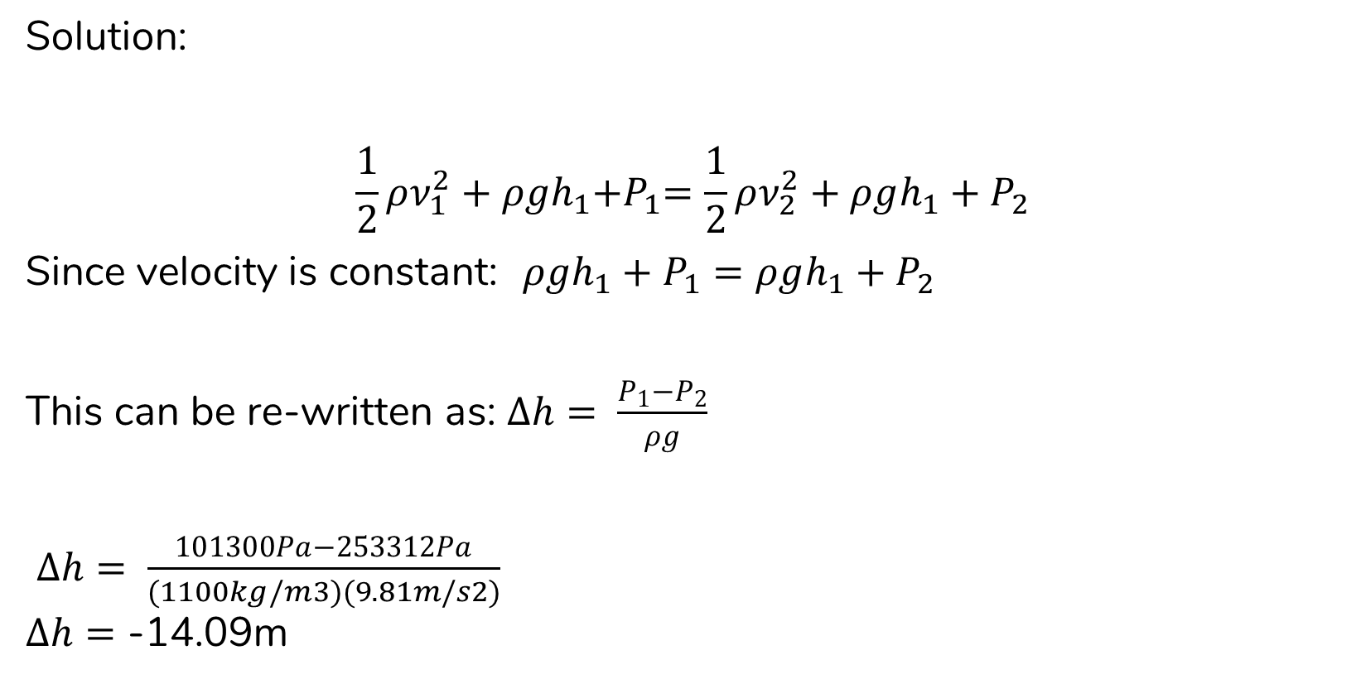
QUESTION 12
What must be the drop of height of a pipe in order to achieve a pressure of 2.5atm if the initial pressure is set at atmospheric value? Assume that the fluid velocity is constant with a density of 1100kg/m3.
Solution:
$$\frac{1}{2}ρν_{1}^{2}+ρgh_{1}{+P}_{1}=\frac{1}{2}ρν_{2}^{2}+ρgh_{1}+P_{2}$$
Since velocity is constant: $ρgh_{1}+P_{1}=ρgh_{1}+P_{2}$
This can be re-written as: $∆h= \frac{P_{1}−P_{2}}{ρg}$
$∆h= \frac{101300Pa−253312Pa}{(1100kg/m3)(9.81m/s2)}$
$∆h=$ -14.09m
-14.09m
-18.2m
-16.57m
-14.33m
Reference: https://www.fsl.orst.edu/geowater/FX3/help/8_Hydraulic_Reference/Froude_Number_and_Flow_States.htm
ATTRTC ABELE Review 2024
ATTRC ABELE Review 2025
Irrigation and Drainage Engineering | Fluid Mechanics
Irrigation and Drainage Engineering | Fluid Mechanics

Slide 31

QUESTION 13
A horizontal fully flowing, 4-inch pipe is discharging water. The X-coordinate and Y-coordinate of the water trajectory as measured from the end of the pipe are 1.5 m and 0.8 m, respectively. Assuming that the coefficient of discharge is 1.0. What is the discharge of the pipe?
Formula for hydraulic jump:
Q = 3.6 $\frac{\text{AX}}{\sqrt{\text{Y}}}$
Where: Q = GPM
A = in²
X and Y = in
8.34lps
30.03lps
132.23lps
476.04lps
Reference: https://www.fsl.orst.edu/geowater/FX3/help/8_Hydraulic_Reference/Froude_Number_and_Flow_States.htm
ATTRTC ABELE Review 2024
ATTRC ABELE Review 2025
Irrigation and Drainage Engineering | Fluid Mechanics
Irrigation and Drainage Engineering | Fluid Mechanics

Slide 32


QUESTION 13
A horizontal fully flowing, 4-inch pipe is discharging water. The X-coordinate and Y-coordinate of the water trajectory as measured from the end of the pipe are 1.5 m and 0.8 m, respectively. Assuming that the coefficient of discharge is 1.0. What is the discharge of the pipe?
Solution (Belonio formula):
Q = 3.6 $\frac{\text{AX}}{\sqrt{\text{Y}}}$ where Q = gpm, rest is inches
Q = 3.6 x $\frac{\text{π}\left(\frac{4^{2}}{4}\right)\text{(}\text{1.5}\text{m} \text{x} \frac{1in}{0.0254m}\text{)}}{\sqrt{\text{(}\text{0.8}\text{m} \text{x} \frac{1in}{0.0254m}\text{)}}}$
Q = 476.04gpm x $\frac{0.06309lps}{1gpm}$
Q = 30.03lps
Alternative solution:
Q = CdA$\sqrt{2gh}$ where h = x – y Q = m3/s, rest is meters
Q = (1.0) $\left(\text{π}\left(\frac{{(4 x 0.0254)}^{2}}{4}\right)\right)$ $\sqrt{2\left(\frac{9.81m}{s2}\right)(1.5 −0.8)}$
Q = 0.03004m3/s or 30.04lps
8.34lps
30.03lps
132.23lps
476.04lps
Reference: https://www.fsl.orst.edu/geowater/FX3/help/8_Hydraulic_Reference/Froude_Number_and_Flow_States.htm
ATTRTC ABELE Review 2024
ATTRC ABELE Review 2025
Irrigation and Drainage Engineering | Fluid Mechanics
Irrigation and Drainage Engineering | Fluid Mechanics

Slide 33
THANK YOU
ABELE | 2025
ATTRC - Iligan City

